Slide 1
Title: Detection of AI-Generated Arabic Text
Advanced Data Analytic Techniques
Presented by: Sohila Mohey Mahmoud

Slide 2
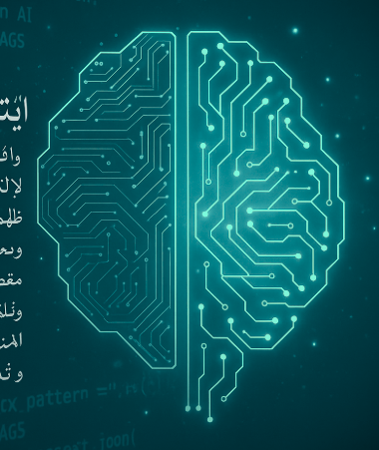
Problem Statement
Arabic AI-text detection is still underdeveloped compared to English.
Large Language Models (LLMs) like GPT-4, LLaMA, Jais can generate Arabic text almost identical to human writing.
The lack of annotated Arabic datasets makes it difficult to detect AI-generated content.
This raises risks in academic integrity, fake research, and digital misinformation.

Slide 3
Preprocessing & Data Normalization
A multi-stage preprocessing pipeline was implemented to handle the linguistic complexity of Arabic:
Text Normalization:
Unify letter forms (أ / إ / آ → ا, ى → ي, ة → ه).
Remove diacritics (tashkeel), digits, and special symbols.
Structural Cleaning:
Remove HTML tags, URLs, and email addresses.
Delete repeated punctuation and character elongations.
Normalize whitespace.

Slide 4
Preprocessing & Data Normalization Con’t
Tokenization & Stopword Removal:
Used NLTK Arabic tokenizer and extended stopword lists (NLTK + GitHub custom).
Morphological Processing:
ISRI stemming to reduce words to root forms.
Stanza lemmatization to preserve grammatical meaning.
Quality Assurance:
Logs were used to track preprocessing errors.

Slide 5
Feature Engineering
Short Word Ratio (≤ 3 letters)
AI:
Jais: 10.8% (highest – frequent short connectors).
Allam: 9.7%, LLaMA: 8.9%, OpenAI: 8.1%.
Original: 9.8% (natural use of short function words).
Insight: Human and Jais texts show richer linguistic flow; OpenAI more formal and structured.

Slide 6
Feature Engineering Con’t
2. Sentence Count & Structure
AI:
Allam: 4.49, Jais: 5.91, LLaMA: 5.66, OpenAI: 6.50 sentences on average.
Original: 7.43 sentences (longer and more complex).
Insight: Human texts are more segmented and syntactically rich; AI outputs are concise and dense.
3. Foreign Letters Ratio
AI: LLaMA: 0.98, Allam & Jais: 0.49, OpenAI: 0.29.
Original: 0.83 (includes real English abbreviations or citations).
Insight: Human writing often mixes Arabic with foreign symbols; AI-generated text remains purely Arabic.

Slide 7
Feature Engineering Con’t
4. Redundancy Score
AI: Allam: 0.56, LLaMA: 0.55, Jais: 0.54, OpenAI: 0.52.
Original: 0.39 (much lower repetition).
Insight: AI-generated abstracts are more repetitive and template-like; human writing is diverse and context-driven.
5. Vocabulary Richness (TTR)
AI: 0.70–0.79 range.
Original: 0.798 (highest diversity).
Insight: Human abstracts use a broader and more varied vocabulary.

Slide 8
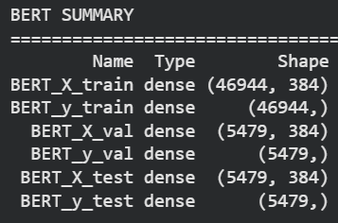
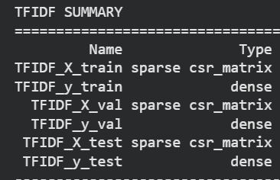
Embeddings & Data Splitting
TF-IDF (Term Frequency–Inverse Document Frequency)
Used to represent texts numerically based on word frequency.
Captures lexical patterns and stylistic differences—ideal for classical ML models.
BERT Embeddings (Contextual Representation)
Transforms text into dense vectors capturing meaning and context.
Enables deep models to understand semantics beyond surface words.
Data Splitting (70 / 15 / 15 : Train / Validation / Test)
Ensures fair model evaluation and prevents data leakage.
Training used for fitting, validation for tuning, and test for final performance check.

Slide 9
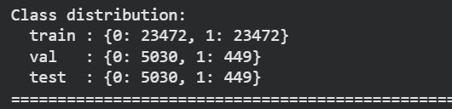
Data Balancing & Feature Scaling
SMOTE:
Balanced the dataset by generating synthetic samples for the minority (human-written) class to prevent model bias.
StandardScaler:
Normalized numerical features (zero mean, unit variance) to improve model convergence and performance consistency.

Slide 10
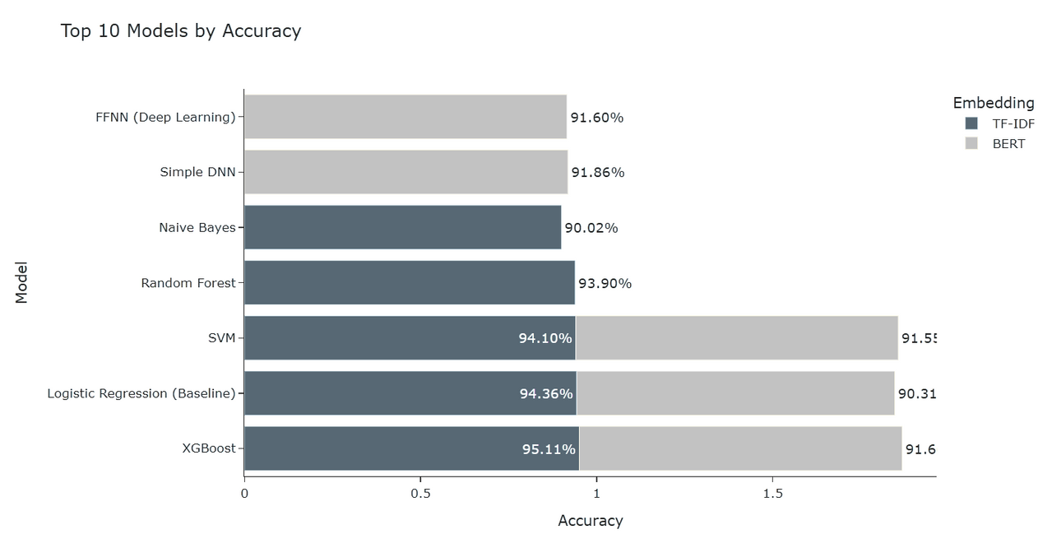
Results & Analysis
TF-IDF features were more effective for traditional ML models.
XGBoost provided the best balance between accuracy and interpretability.
BERT embeddings worked better for deep models, improving contextual generalization.
Stylometric analysis validated these results — AI-generated texts were shorter, more redundant, and structurally repetitive compared to human texts.

Slide 11
Conclusion
Developed a complete Arabic AI-text detection pipeline — from data collection to model evaluation.
Built a custom Arabic preprocessing framework with normalization, diacritics removal, stemming, and lemmatization (Stanza + ISRI).
Extracted stylometric features such as sentence count, redundancy score, short-word ratio, and vocabulary richness to capture writing patterns.
Applied SMOTE to balance the dataset and StandardScaler to normalize numerical features, ensuring fair model training and consistent performance.
Compared TF-IDF (lexical) and BERT (contextual) embeddings across classical and deep learning models.
XGBoost with TF-IDF achieved the best overall performance (95.1% accuracy, 0.950 F1-score), confirming the strength of lexical features for Arabic text classification.

Slide 12
Thanks

